Slide 1
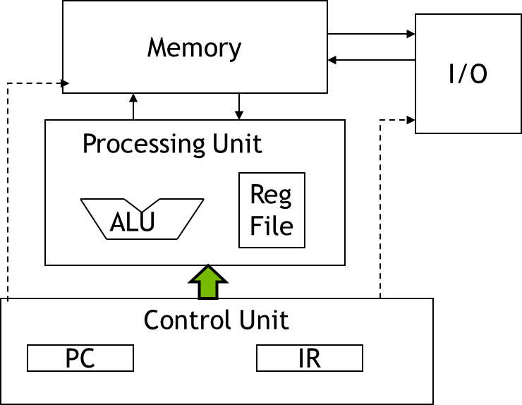
The Von Neumann Model

Slide 2
ALU: Arithmetic Logic Unit
ALU should perform:
Addition
Subtraction
AND
OR

Slide 3
ALU: Arithmetic Logic Unit
ALUControl_{1:0} | Function
00 | Add
01 | Subtract
10 | AND
11 | OR

Slide 4
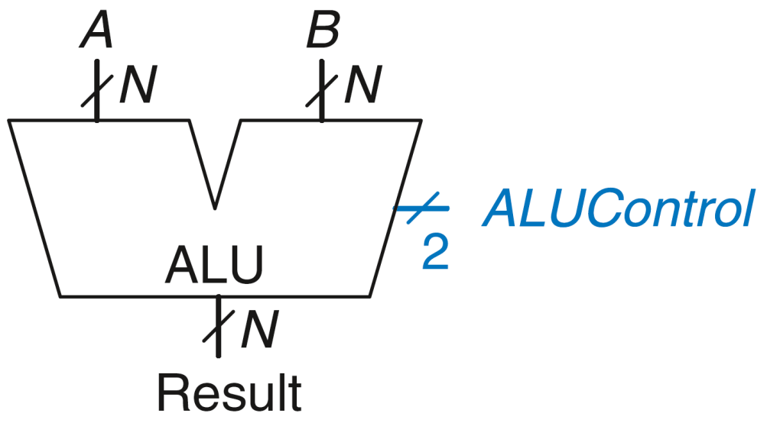
ALU: Arithmetic Logic Unit
ALUControl_{1:0} | Function
00 | Add
01 | Subtract
10 | AND
11 | OR

Slide 5
ALU: Arithmetic Logic Unit
ALUControl_{1:0} | Function
00 | Add
01 | Subtract
10 | AND
11 | OR
Example: Perform A + B
ALUControl = 00
Result = A + B

Slide 6
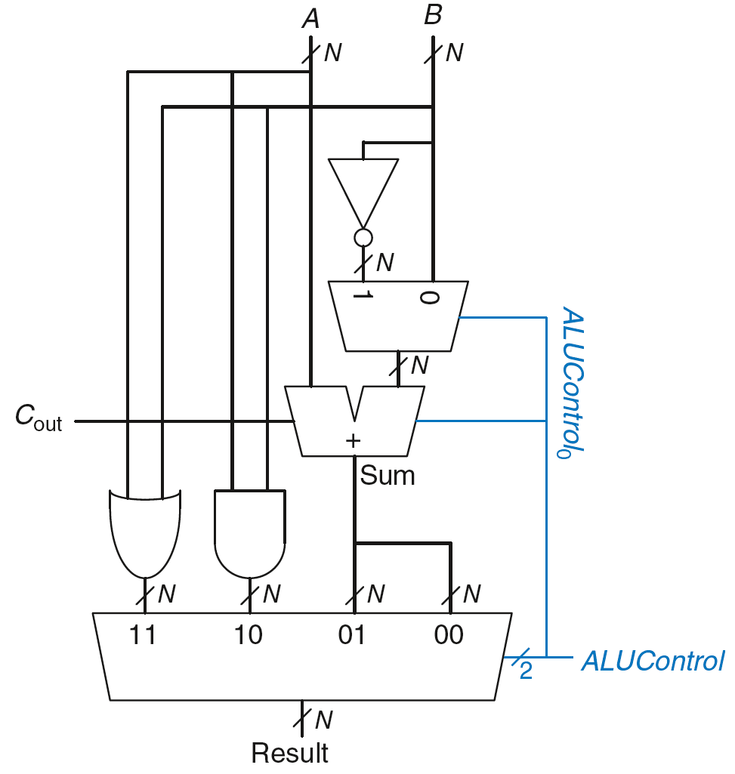
ALU: Arithmetic Logic Unit
ALUControl_{1:0} | Function
00 | Add
01 | Subtract
10 | AND
11 | OR
Example: Perform A OR B

Slide 7
ALU: Arithmetic Logic Unit
ALUControl_{1:0} | Function
00 | Add
01 | Subtract
10 | AND
11 | OR
Example: Perform A OR B
ALUControl_{1:0} = 11
Mux selects output of OR gate as Result, so
Result = A OR B

Slide 8
ALU: Arithmetic Logic Unit
ALUControl_{1:0} | Function
00 | Add
01 | Subtract
10 | AND
11 | OR
Example: Perform A + B

Slide 9
ALU: Arithmetic Logic Unit
ALUControl_{1:0} | Function
00 | Add
01 | Subtract
10 | AND
11 | OR
Example: Perform A + B
ALUControl_{1:0} = 00
ALUControl₀ = 0, so:
Cin to adder = 0
2nd input to adder is B
Mux selects Sum as Result, so
Result = A + B

Slide 10
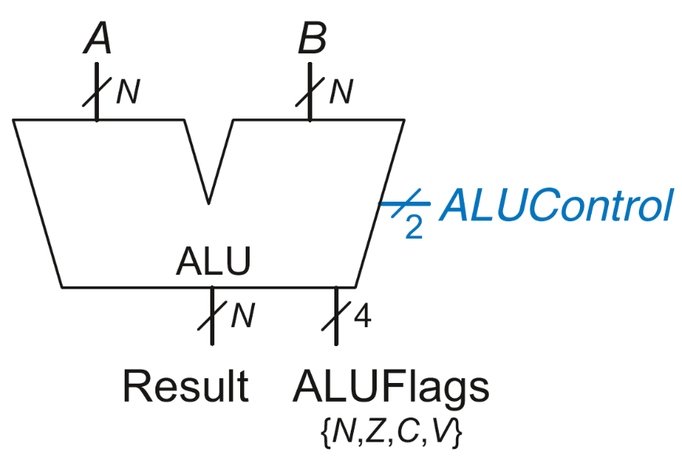
ALU with Status Flags
Flag | Description
N | Result is Negative
Z | Result is Zero
C | Adder produces Carry out
V | Adder oVerflowed

Slide 11
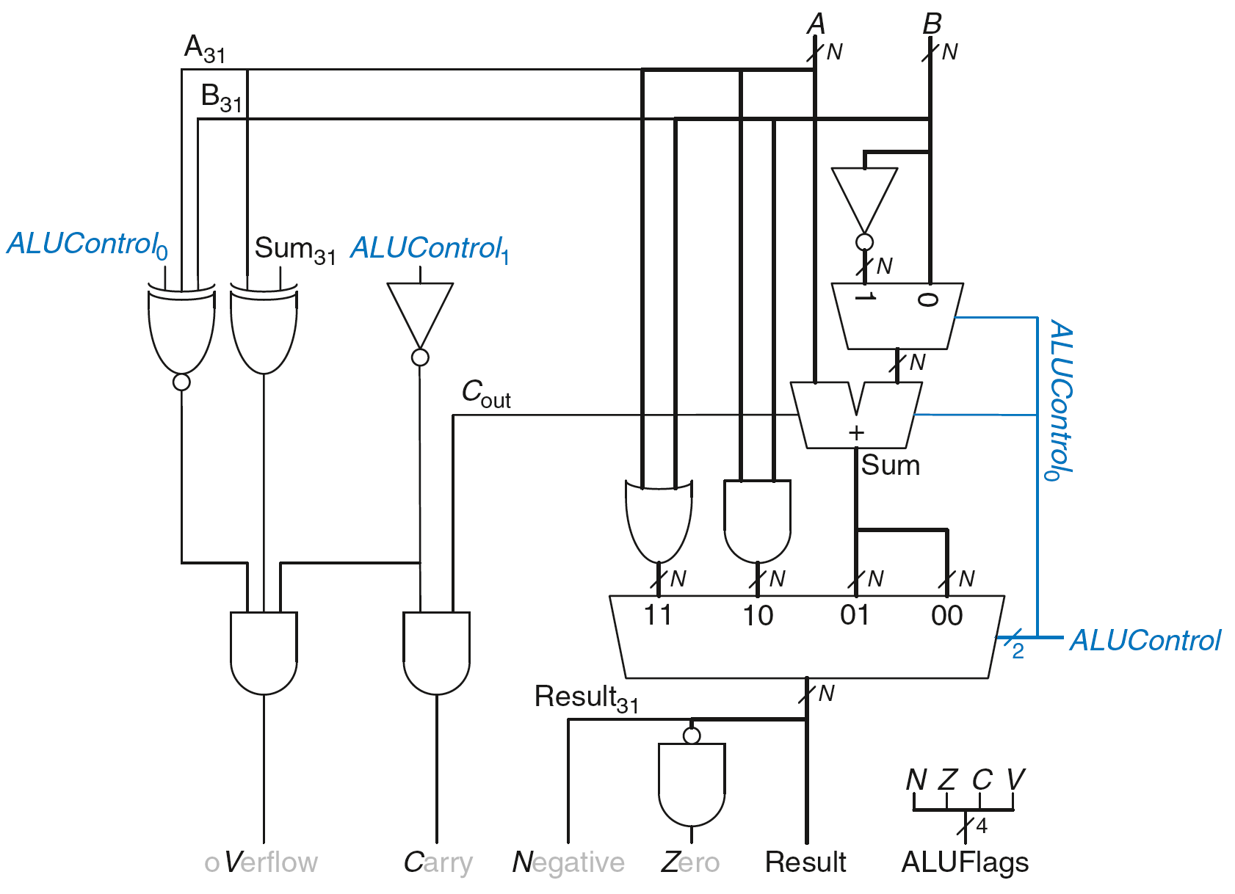
ALU with Status Flags

Slide 12
ALU with Status Flags: Negative
N = 1 if:
Result is negative
So, N is connected to most significant bit of Result

Slide 13
ALU with Status Flags: Zero
Z = 1 if:
all of the bits of Result are 0

Slide 14
ALU with Status Flags: Carry
C = 1 if:
C_{out} of Adder is 1
AND
ALU is adding or subtracting (ALUControl is 00 or 01)

Slide 15
ALU with Status Flags: oVerflow
V = 1 if:
The addition of 2 same-signed numbers produces a result with the opposite sign

Slide 16
ALU with Status Flags: oVerflow
V = 1 if:
ALU is performing addition or subtraction
(ALUControl₁ = 0)

Slide 17
ALU with Status Flags: oVerflow
V = 1 if:
ALU is performing addition or subtraction
(ALUControl₁ = 0)
AND
A and Sum have opposite signs

Slide 18
ALU with Status Flags: oVerflow
V = 1 if:
ALU is performing addition or subtraction
(ALUControl₁ = 0)
AND
A and Sum have opposite signs
AND
A and B have same signs upon addition OR
A and B have different signs upon subtraction

Slide 19
ALU with Status Flags: oVerflow
V = 1 if:
ALU is performing addition or subtraction
(ALUControl₁ = 0)
AND
A and Sum have opposite signs
AND
A and B have same signs upon addition (ALUControl₀ = 0) OR
A and B have different signs upon subtraction
(ALUControl₀ = 1)

Slide 20
ALU with Status Flags

Slide 21
Esercizio PLA

Slide 22
Esercizio PLA

Slide 23
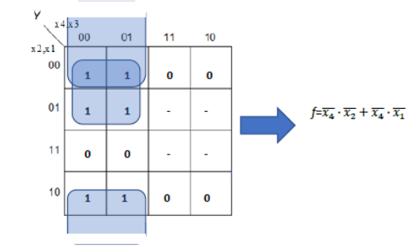
Esercizio PLA

Slide 24
Esercizio PLA

Slide 25
Esercizio PLA

Slide 26
Esercizio PLA

Slide 27
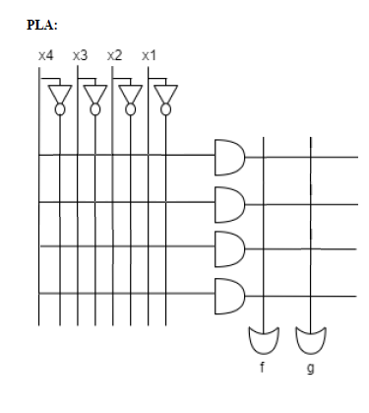
Esercizio PLA

Slide 28
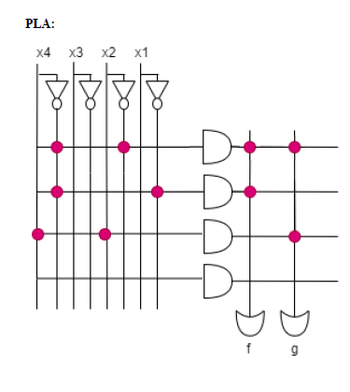
Esercizio PLA

